Slide 1
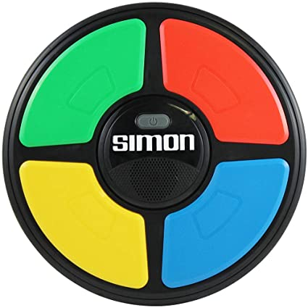
Simon Says! Coded by: Joseph (Joey) Cellino
The game of memory and pattern repetition!
The user will first start the game by being played a series of random flashing lights & then be prompted to recite the pattern back in the correct order. If the player input does not match the exact pattern that was originally played for them, it will be game over!

